Slide 1
Employee Salary Prediction Using Streamlit application - app
CAPSTONE PROJECT
Presented By:
Student Name: Guru Brahma Gudimetla
College Name: PBR VITS
Department: Electronics & communication Engineering
AICTE STU ID: STU670691bf4b9a31728483775
GitHub Link : https://github.com/Gurubrahma1982/Employee-Salary-Prediction-Streamlit-library-App.git

Slide 2
OUTLINE
Problem Statement (Should not include solution)
System Development Approach (Technology Used)
Algorithm & Deployment (Step by Step Procedure)
Result
Conclusion
Future Scope(Optonal)
References

Slide 3
Problem Statement
The goal of this project is to predict an employee's salary based on their age and years of experience using a machine learning model.
It aims to eliminate guesswork in hiring and offer data-driven salary estimation.
The system provides an interactive Streamlit web app to input employee details and view real-time salary predictions.
The project helps HR teams and startups to forecast salary budgets. It also introduces students to practical machine learning deployment.
It always helpful to a fresher for noticing about his/her salary expectations.

Slide 4
System Approach
System Requirements:
Python 3.10+
VS Code / Jupyter / Terminal
Streamlit for deployment
Libraries Used:
pandas
scikit-learn
joblib
Streamlit
Model Used: Linear Regression Trained On: Age and Years of Experience Deployment:: Streamlit app running locally

Slide 5
Algorithm & Deployment
Steps:
Collected and cleaned dataset with Age, Experience, and Salary.
Split into features (X) and target (y).
Trained a Linear Regression model.
Saved model using joblib.
Built UI with streamlit for sliders and prediction button.
On user input, model predicts salary and displays it.
App is launched using streamlit run app.py.

Slide 6
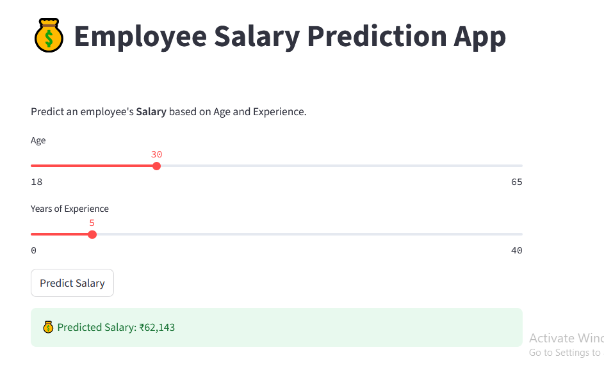
Result
Github link : https://github.com/Gurubrahma1982/Employee-Salary-Prediction-Streamlit-library-App.git

Slide 7
Conclusion
The Employee Salary Prediction project demonstrated that even a simple linear regression model can effectively estimate an employee's salary using just two input features — Age and Years of Experience. The solution was implemented using Python and deployed as a user-friendly web app using Streamlit.
The app is lightweight, runs locally, and provides real-time predictions. It is particularly useful for educational purposes, small businesses, and HR teams who need quick estimations without requiring large datasets or complex infrastructure.
Solution: The app predicts salary based on age and experience using a trained ML model in Streamlit.
Challenges: Matching input features with trained model columns caused errors during testing.
Improvements: Add more fields (like gender, job title) and deploy the app online.
Effectiveness: Simple, fast, and useful for quick salary estimation.

Slide 8
Future scope(Optional)
Add more input fields like education level, job role, and work hours for refined predictions
Enable batch predictions by allowing CSV file uploads for multiple employees
Deploy the system online to make it accessible from any device
Add data visualization to show trends like salary vs experience or age
Integrate login & user management for enterprise or HR team use

Slide 9
References
Scikit-learn Documentation
Streamlit Official Docs
Pandas Library
IBM SkillsBuild Internship Resources
YouTube – “Build a Salary Prediction ML App using Streamlit” tutorials
Kaggle Community – For dataset references and project inspiration
Stack Overflow – For debugging and Streamlit error fixes

Slide 10
THANK YOU

